Slide 1




Embedded module for detection and recognition of miniature traffic signs using neural networks
Student: Mihai-Bogdan Bindila

Slide 2
Contents
Context - Bosch Future Mobility Challenge 2020
Overview
System architecture
Dataset preparation
Convolutional Neural Network
Network training
Model conversion for inference in C++
Pipeline
Preprocessing 1
Pipeline for pole extraction
Preprocessing 2
Prediction and distance to sign
Results
Conclusions
References

Slide 3
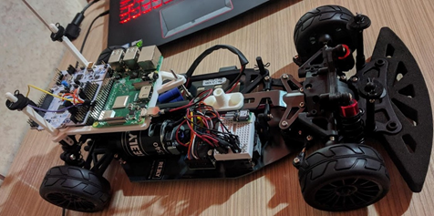
Context - BFMC 2020
-> The module is a component of the car with which the Back On Track team has competed at BFMC 2020.
-> The car is built on a 1/10 scale.
-> The car must be autonomous.
-> The algorithm runs on a Raspberry Pi 4 Model B - 4GB.
-> There is a serial connection between the Raspberry Pi and a Nucleo F401RE microcontroller.
-> The microcontroller operates the car according to the messages received from the Raspberry Pi.

Slide 4
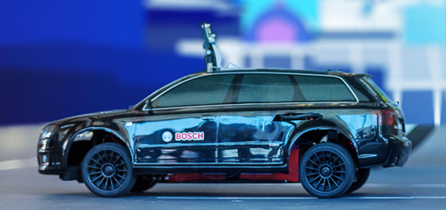
Context - BFMC 2020
-> The rest of the algorithms that must be implemented are:
- Line keeping
- Object avoidance
- Side parking
- Track completion guided by a GPS
- Pedestrian and ramp detection

Slide 5
Overview
-> The module runs on an embedded system with limited resources.
-> The ROI detection algorithm was prototyped in Python and rewritten in C++ for efficiency. The OpenCV library was used for image processing.
->Detection is based on two pipelines that run in parallel:
- the first one is based on pole detection
- the second one is used as a backup solution and generates a color-based segmentation
-> A feed-forward neural network developed in Tensorflow and Keras classifies ROIs.
-> The algorithm is fully autonomous, thus is no need for calibration of the parameters for different scenarios.
Notes:
czzzjzj

Slide 6
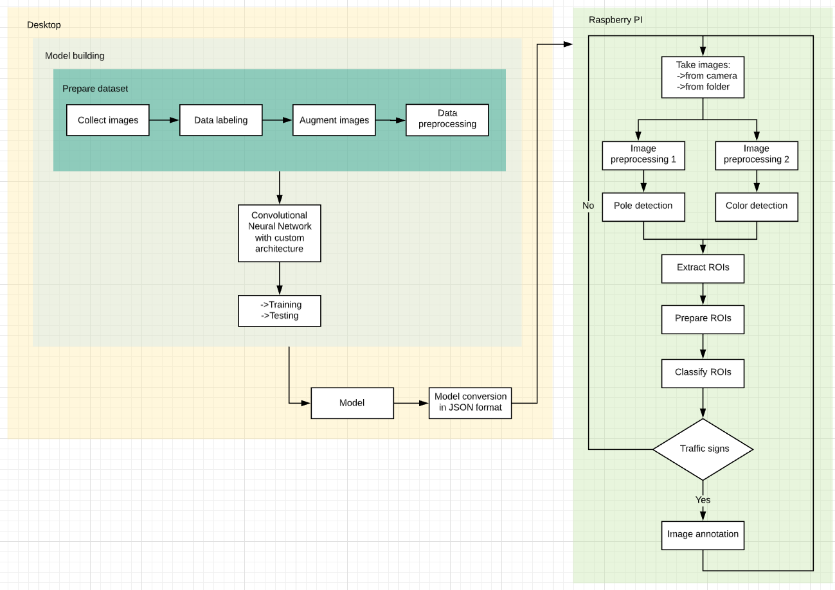
System architecture

Slide 7
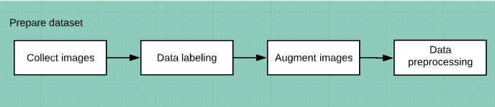
Dataset preparation - sources of images and pipeline
-> The images come from 3 sources: - clips received from the contest organizers
- clips recorded in various locations
- German Traffic Sign Benchmark dataset
->The images from the first two sources were captured with Raspberry Pi Camera v2.1. The algorithm for ROIs detection has extracted the areas of interest.

Slide 8
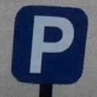





Dataset preparation - augmentation
->The images were divided into the training set and the test set. Image classes are stop, parking, priority road, pedestrian crossing and others.
-> In terms of augmentation, the ImageDataGenerator from the Keras API was used. The transformations applied are scaling, rotations, zoom-in, zoom-out, changes in brightness and shift of color channels.
-> After augmentation, there are 950 images for training and 350 images for testing in each class.
->
Augmentation example

Slide 9
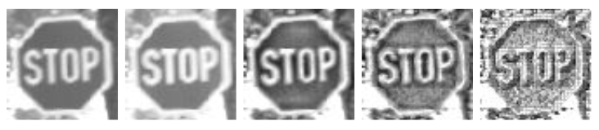
Dataset preparation - preprocessing
-> Preprocessing consisted of resizing images to 64x64 pixels, followed by a grayscale conversion and applying a contrast limited adaptive histogram equalization (CLAHE).
-> For the last operation different values of the pixel patch size were tried, but the best results were obtained for 8x8 pixels patches.
-> Applying a histogram equalization on the images of the dataset brings a boost to the accuracy of the network, as demonstrated in the paper [1].
CLAHE with different sizes of the patch

Slide 10
Convolutional Neural Network - model selection
-> For model selection Grid Search algorithm was used.
-> There were tried different types of architectures varying: -> the types of layers
-> the numbers of units in each layer
-> Hyperparameters that were tried with different values: -> number of epochs
-> batch size
-> learning rate
-> decay rate
-> regularization type -> L1, L2 and L1_L2
-> In the end regularization was replaced with batch normalization that brings more benefits.

Slide 11
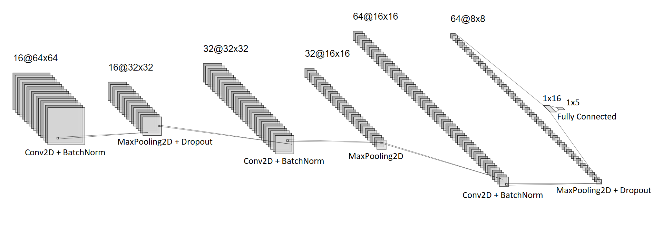
Convolutional Neural Network - architecture
-> A feed-forward convolutional neural network is used. It has 5 principal types of layers: convolution, max pooling, fully connected, dropout and batch normalization. To avoid overfitting there are two dropout layers, first with a value of 0.2 and the second one with 0.5. Batch Normalization was used to allow higher learning rates.

Slide 12
Convolutional Neural Network - architecture
-> The activation function for the last layer is Sigmoid, which replaces the classic Softmax. The loss used is a binary cross-entropy, so the problem becomes a classification of type one versus all.
-> It turns out that the prediction is no longer represented by a probability distribution with the sum equal to 1, instead each class can has a probability between 0 and 1.
-> A prediction is considered correct if the highest probability out of the 5 is greater than 99%.
-> The network has just 89,381 parameters compared to similar networks like MobileNetV2 that has 3.4 millions.

Slide 13
Network training
-> For training the best results were obtained using a batch of 16 images and the Adam optimizer. The learning rate was set to 3e-5 and was decayed by 2% from each current value.
-> Overfitting was eliminated by using dropout layers and by monitoring the monotony of the loss function and using the early stopping technique.
-> The results obtained after 100 epochs are: - 96.24% accuracy for the train dataset
- 95.85% accuracy for the test dataset

Slide 14
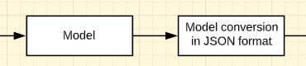
Model conversion for inference in C++
-> Because the model will be used in a module written in C++, a conversion is needed.
-> Initially the model is saved in H5 format which is then converted to JSON format using the Frugally-Deep library.
-> The new model is easy to use in a C ++ code because it only needs 4 header-only libraries to make a prediction based on it.
->Due to the conversion the inference time increases by about 128%.

Slide 15
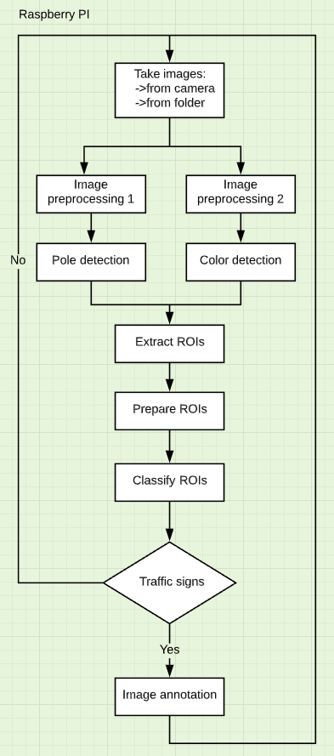
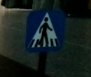
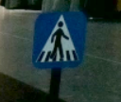
Pipeline
-> Images are taken by the camera or from a local folder. The two preprocessing steps are applied in parallel, after which the extracted ROIs are processed and then classified.
-> Finally, the distance to the sign is measured and depending on the detected traffic sign, a message is sent to the Nucleo microcontroller, which will perform a specific action.
-> The two preprocessing steps have 2 common operations:
- resize to 640x480 pixels
- Gamma compression for highlighting details

Slide 16
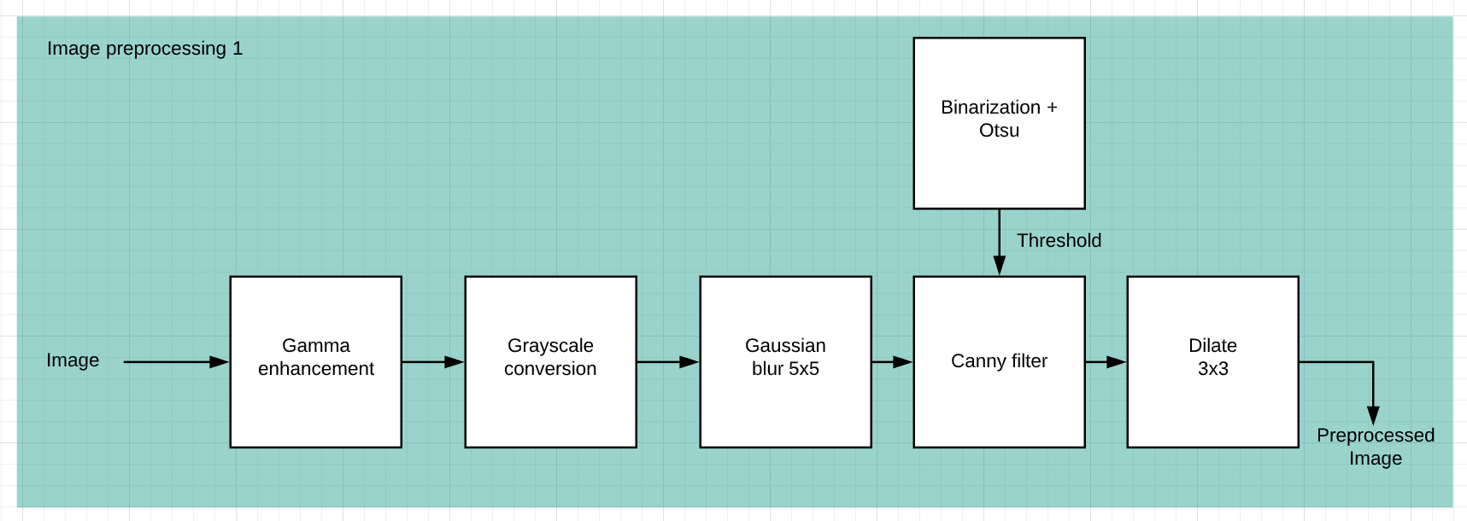
Preprocessing 1
-> This preprocessing pipeline has as input the initial image and generates a picture with the edges of the objects.
-> In the resulting image the pillars of the traffic signs will be detected.

Slide 17
Preprocessing 1 - steps
-> After gamma correction, the following steps are applied:
- Convert BGR color space to grayscale.
- Blur the image with a 5x5 Gaussian filter, with this low-pass filter the weak edges are blurred.
- Apply the Canny filter adaptively for each frame, the threshold value is the same as the threshold value used by the binarization with the Otsu method [2].
- The last step is the application of dilation with 3x3 size to thicken the segments that must be extracted from the image to recognize the pillar.

Slide 18
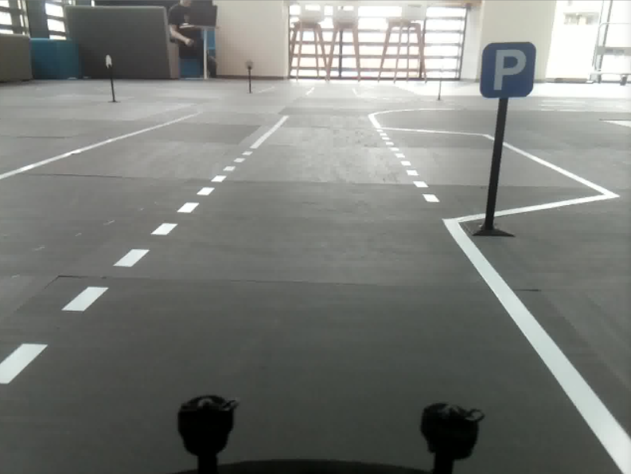
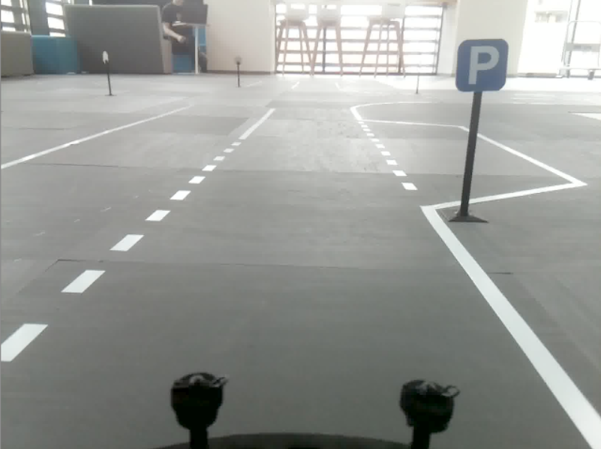
Preprocessing 1 - visualization
->
Initial image Enhanced image

Slide 19
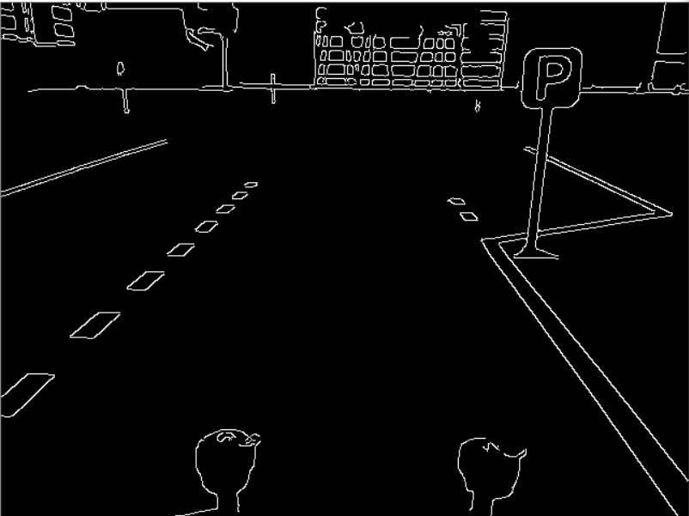

Preprocessing 1 - visualization
->
Canny edge detector Dilated edges

Slide 20
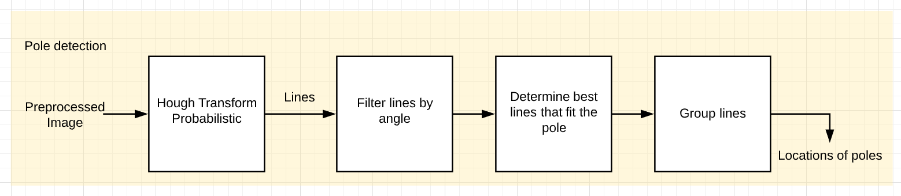
Pipeline for pole extraction
-> Probabilistic Hough Transform is applied to the preprocessed image to determine the set of segments in the picture.
-> The set of segments is filtered so that in the end only the lines that are most likely to be the edges of the column remain.

Slide 21
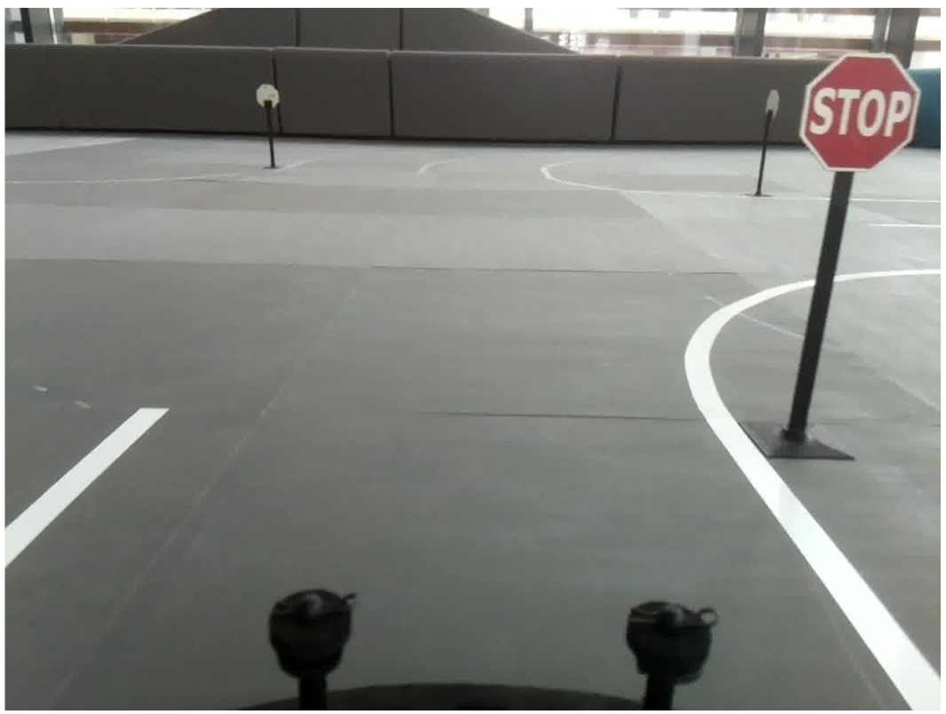
Pipeline for pole extraction
-> The resulting segments are filtered on different criteria, including their angle with the ox axis. It must be between 75 and 105 degrees. At the moment when we approach the column, this inclination appears due to the perspective.
-> Groups are formed with segments that fit one line at a time, and of these, only the one with the minimum y coordinate is retained, which helps us to keep the segment that is most likely to extend to the upper base of the pole.

Slide 22
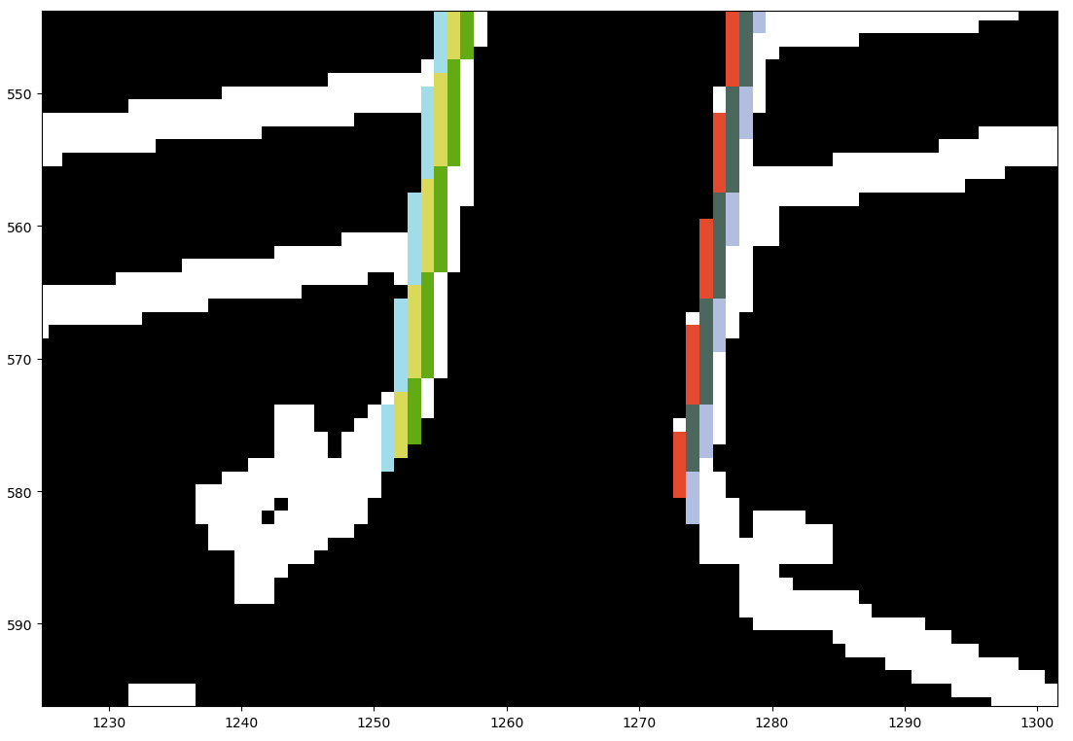
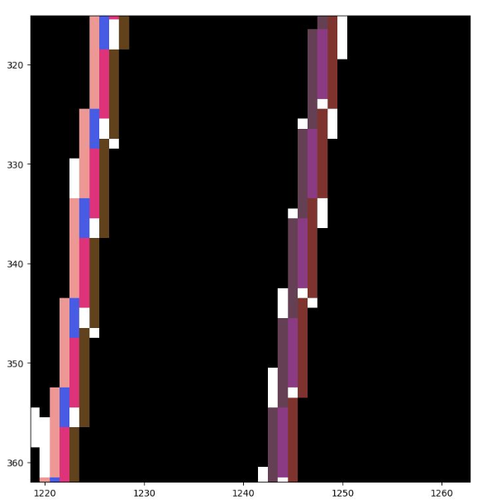
Pipeline for pole extraction
-> To implement this component, each segment was colored with a different color and a 5x5 matrix was centered at the top of each segment to determine the neighbors that will be retained by color.
-> The remaining segments are then grouped based on the criteria given by the distance between them, their length and the level on the oy axis at which they are located.

Slide 23
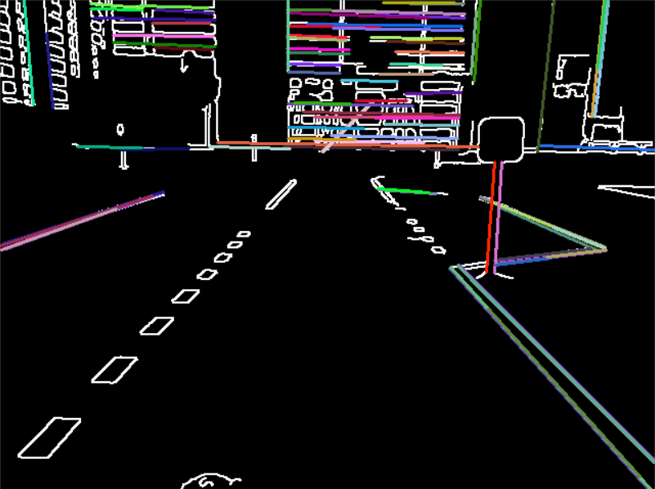
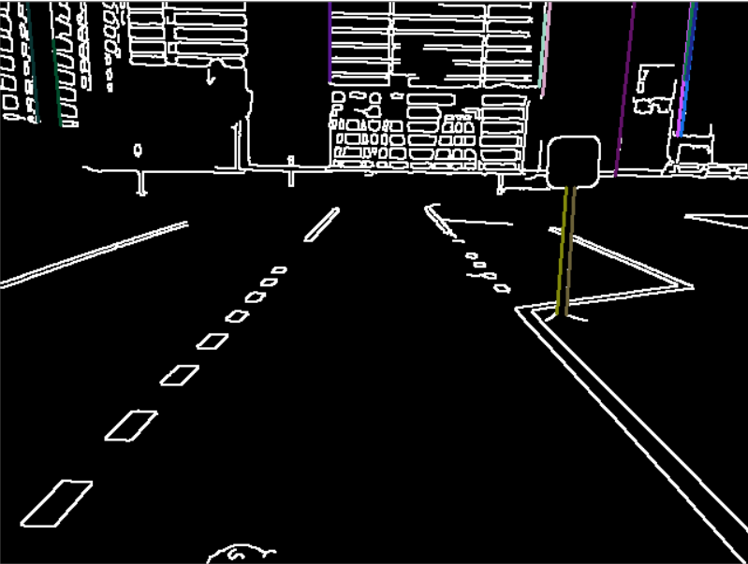
Pipeline for pole extraction - visualization
->
Initial set of segments Set of lines after filtering

Slide 24
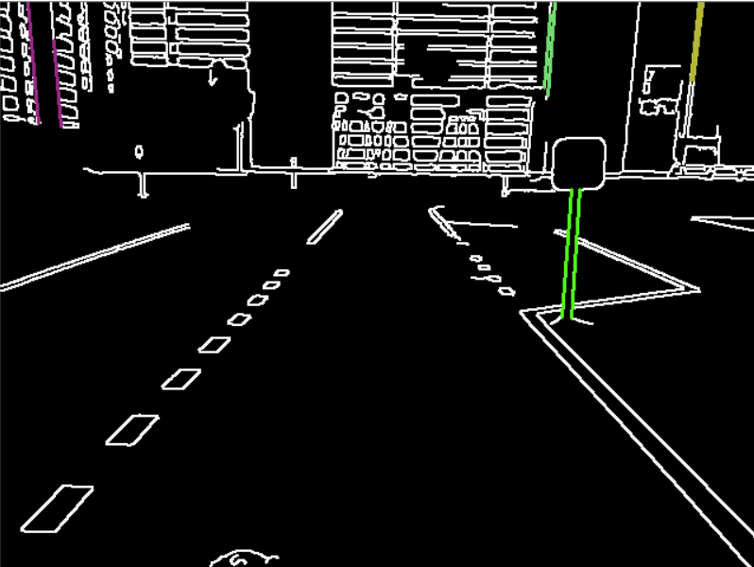
Pipeline for pole extraction - visualization
Groups of lines

Slide 25
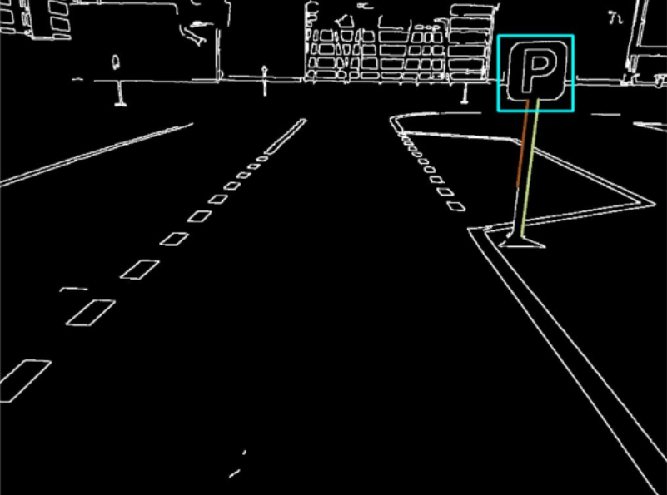
ROI extraction based on pole
-> Depending on the width of the columns, bounding boxes are extracted and also computed taking into consideration the inclination of the pillar.
-> If there is such an inclination, a translation is applied to the left or to the right for the region of interest.
-> These bounding boxes are filtered based on area and proportionality ratio.

Slide 26
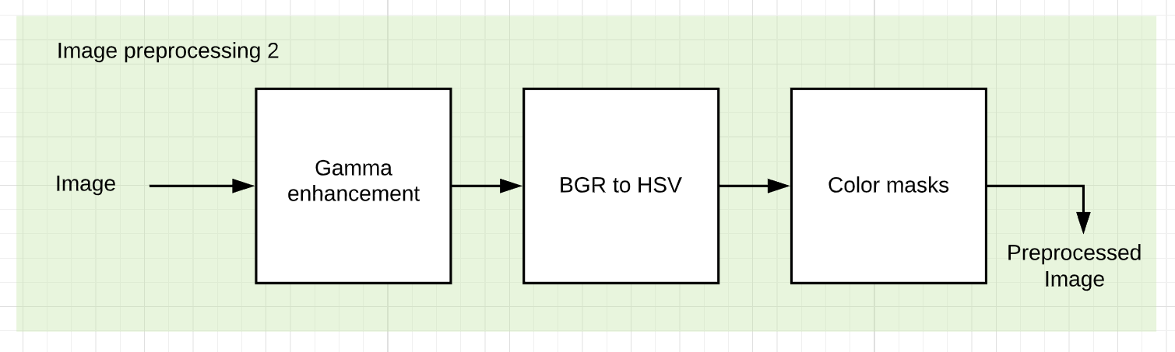
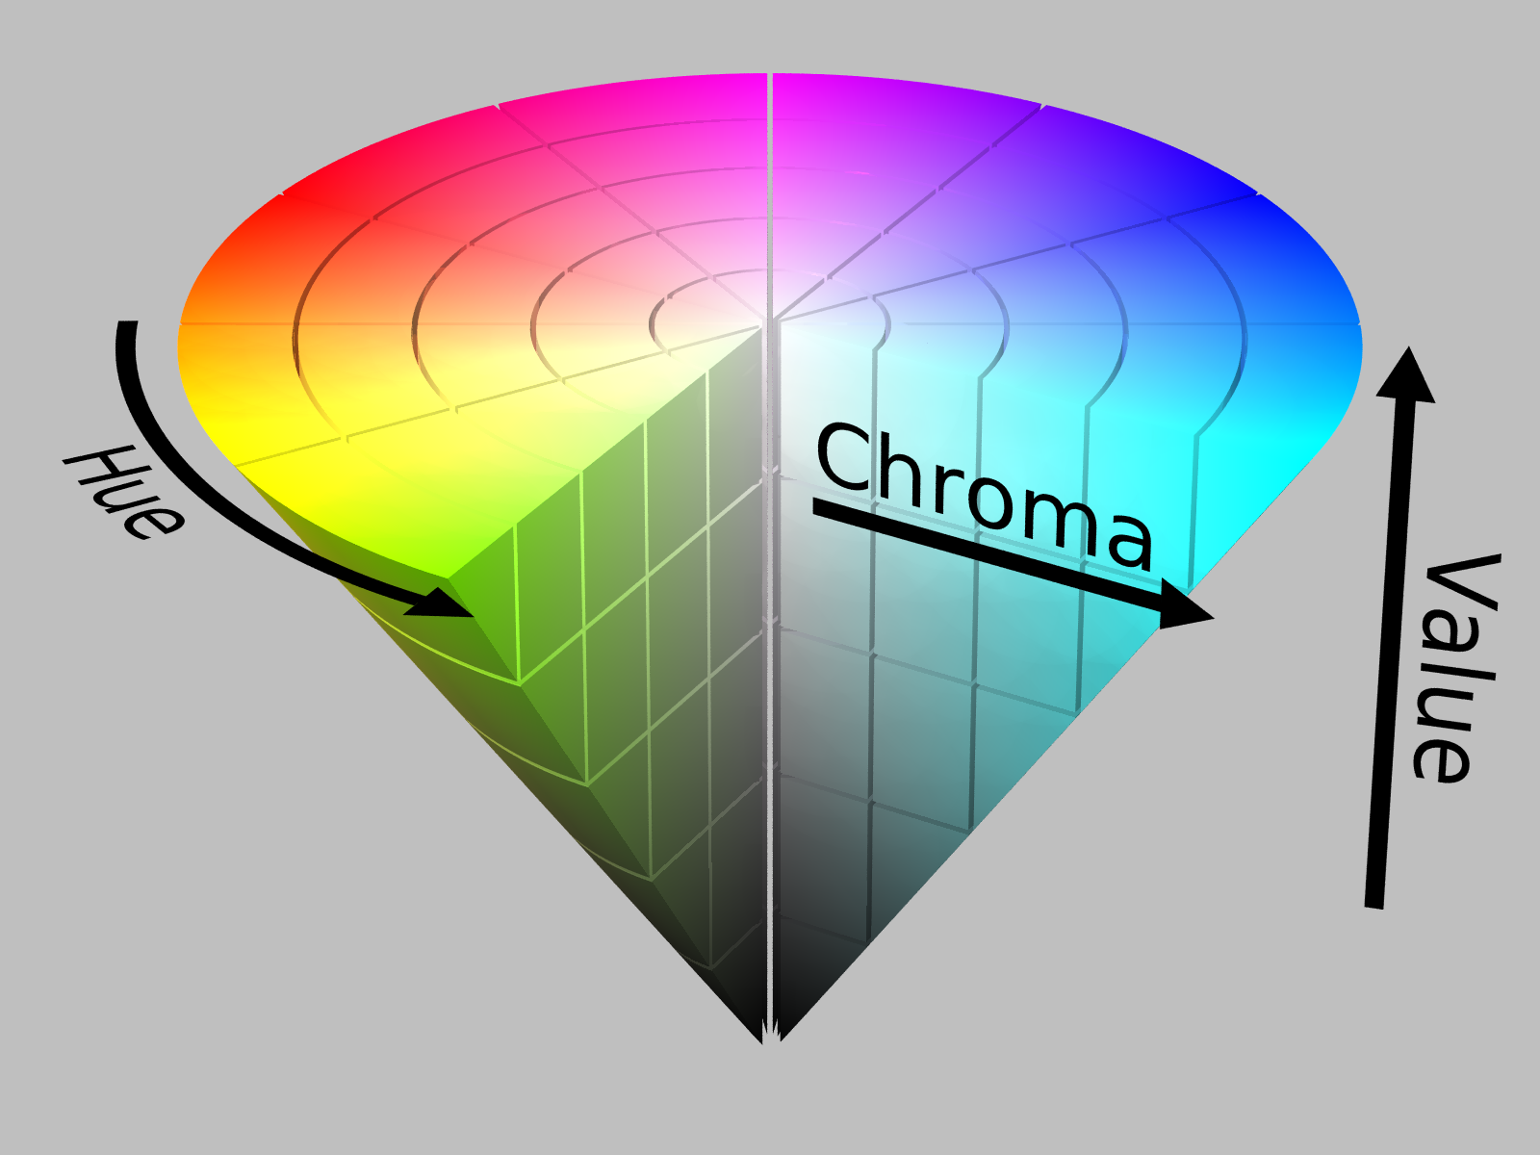
Preprocessing 2 - steps
-> Convert the image from the BGR color space to HSV because the brightness component is separated from the color components. This property helps us to generate a segmentation that makes an abstraction of the brightness from the environment.
HSV color space

Slide 27
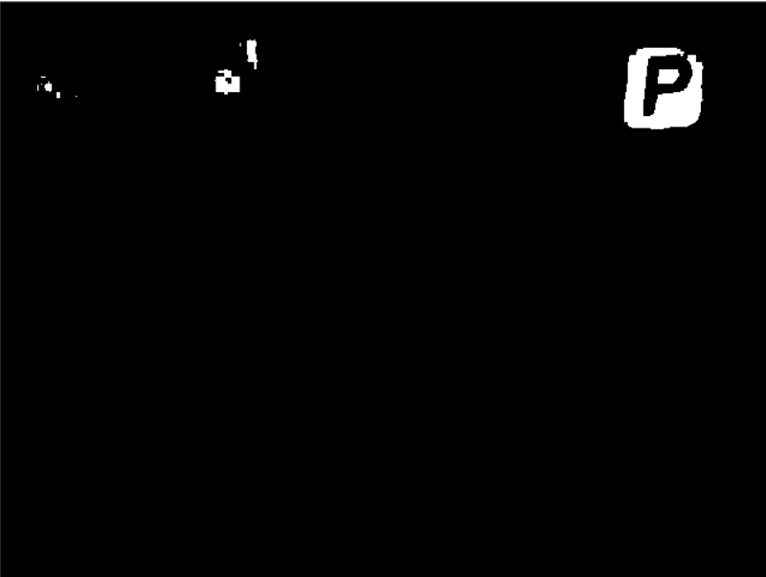
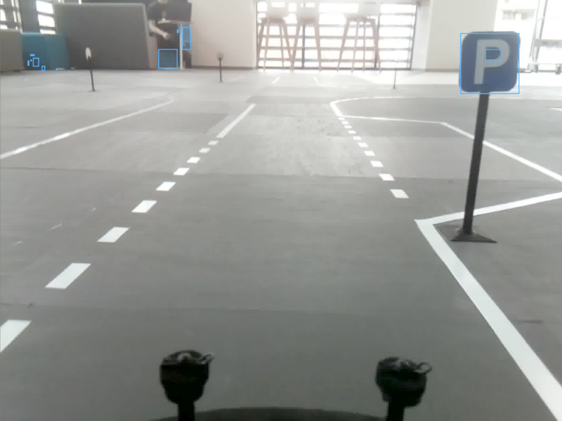

Preprocessing 2 - steps
-> Apply three masks for red, yellow and blue. After this step, the bounding boxes of the connected components are generated.
-> These regions of interest are filtered by area and aspect ratio.
Mask for blue color Extracted ROIs ROIs after filtering

Slide 28
Prediction
-> For each extracted ROI, the following operations must be applied:
- resize to 64x64 pixels
- grayscale conversion
- contrast limited adaptive histogram equalization which is applied on 8x8 pixel patches
-> These preprocessed ROIs are then classified and if the highest probability of the 5 classes is over 99%, then it is considered a correct prediction.
-> The prediction of the traffic signs extracted on the basis of the color information is verified taking into account this information.

Slide 29
Distance to sign
-> When a traffic sign is detected, the distance to it is be computed because the car must make an action at a specific moment.
-> In order to compute the distance the following formula was used:
distance = (sign_width * focal_distance) / sqrt(bb_width_pixels * bb_height_pixels)
-> This formula can be applied because each sign has a known width and height of 6 cm.
-> The dimensions of the bounding box of the sign were used.

Slide 30
Results- performance
-> The algorithm was tested on a laptop with the following specifications:
-> Intel i7 7700hq processor
-> 8GB RAM
-> HDD with 5400 rpm
-> The images are read from the hard disk, 23 fps were obtained in the worst-case scenario, namely in pictures in which there were many regions of interest extracted and classified.
-> If the algorithm runs in scenarios in which all traffic signs have visible poles, then the frame rate increases to 39, due to stopping of the color-based segmentation component.
-> If both pipelines are running, on a Raspberry Pi 4 the algorithm runs at 6 up to 10 fps depending on scene.

Slide 31
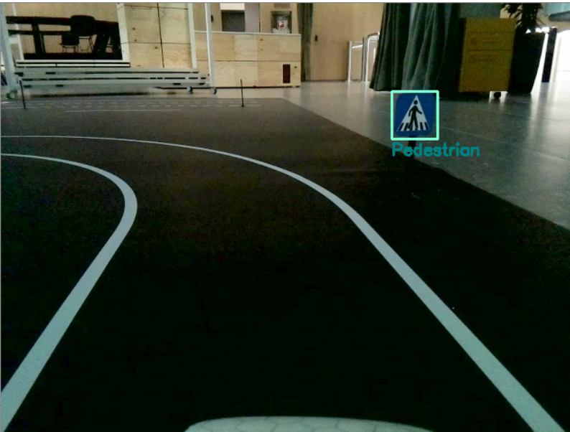
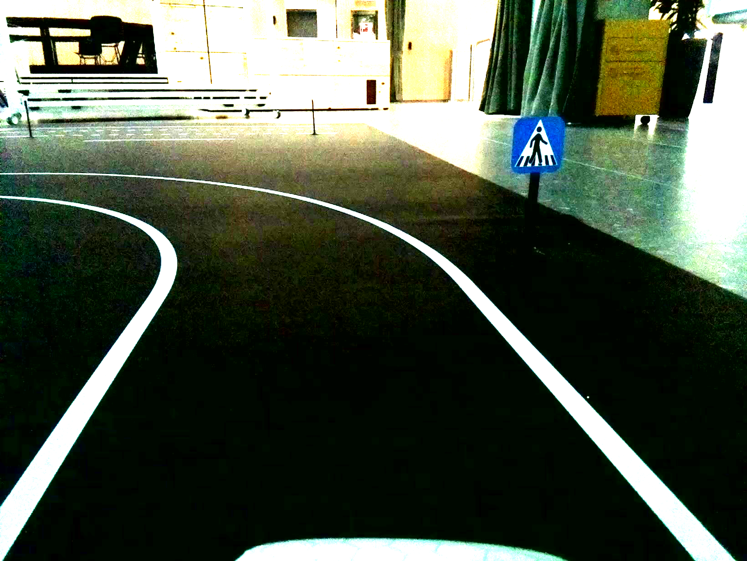
Results - special scenarios
-> The column is not visible even if a lighting factor of 75% is applied.
Detection based on color Lighting increased by 75%

Slide 32
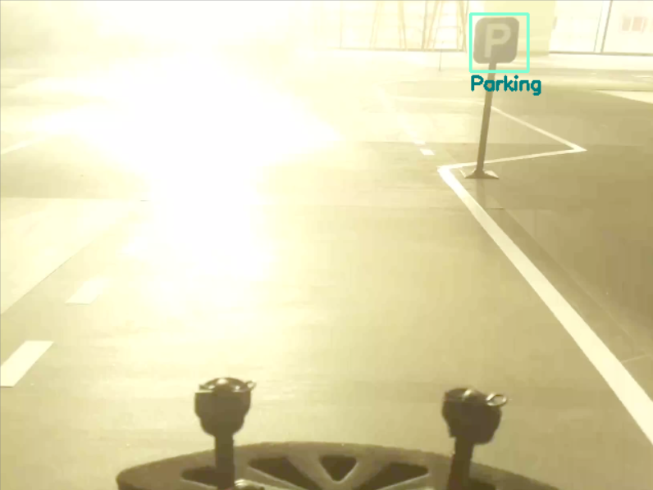


Results - special scenarios
-> There is no accurate representation of colors, so the detection is based on pole.
->
->
Incorrect color representation

Slide 33
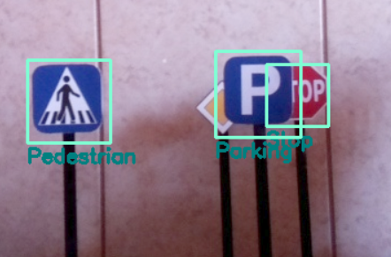
Results - special scenarios
-> There are partial occlusions of the traffic sign.
"STOP" occlusion

Slide 34
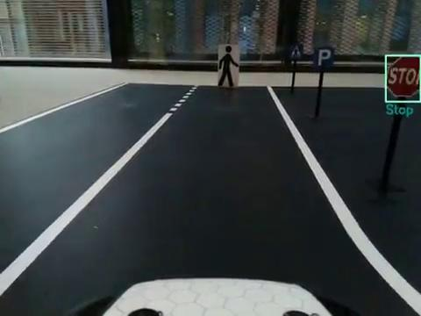
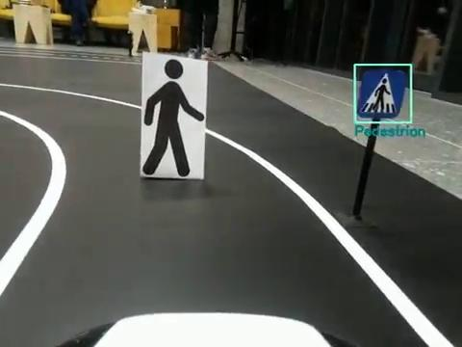
Results - real-time predictions

Slide 35
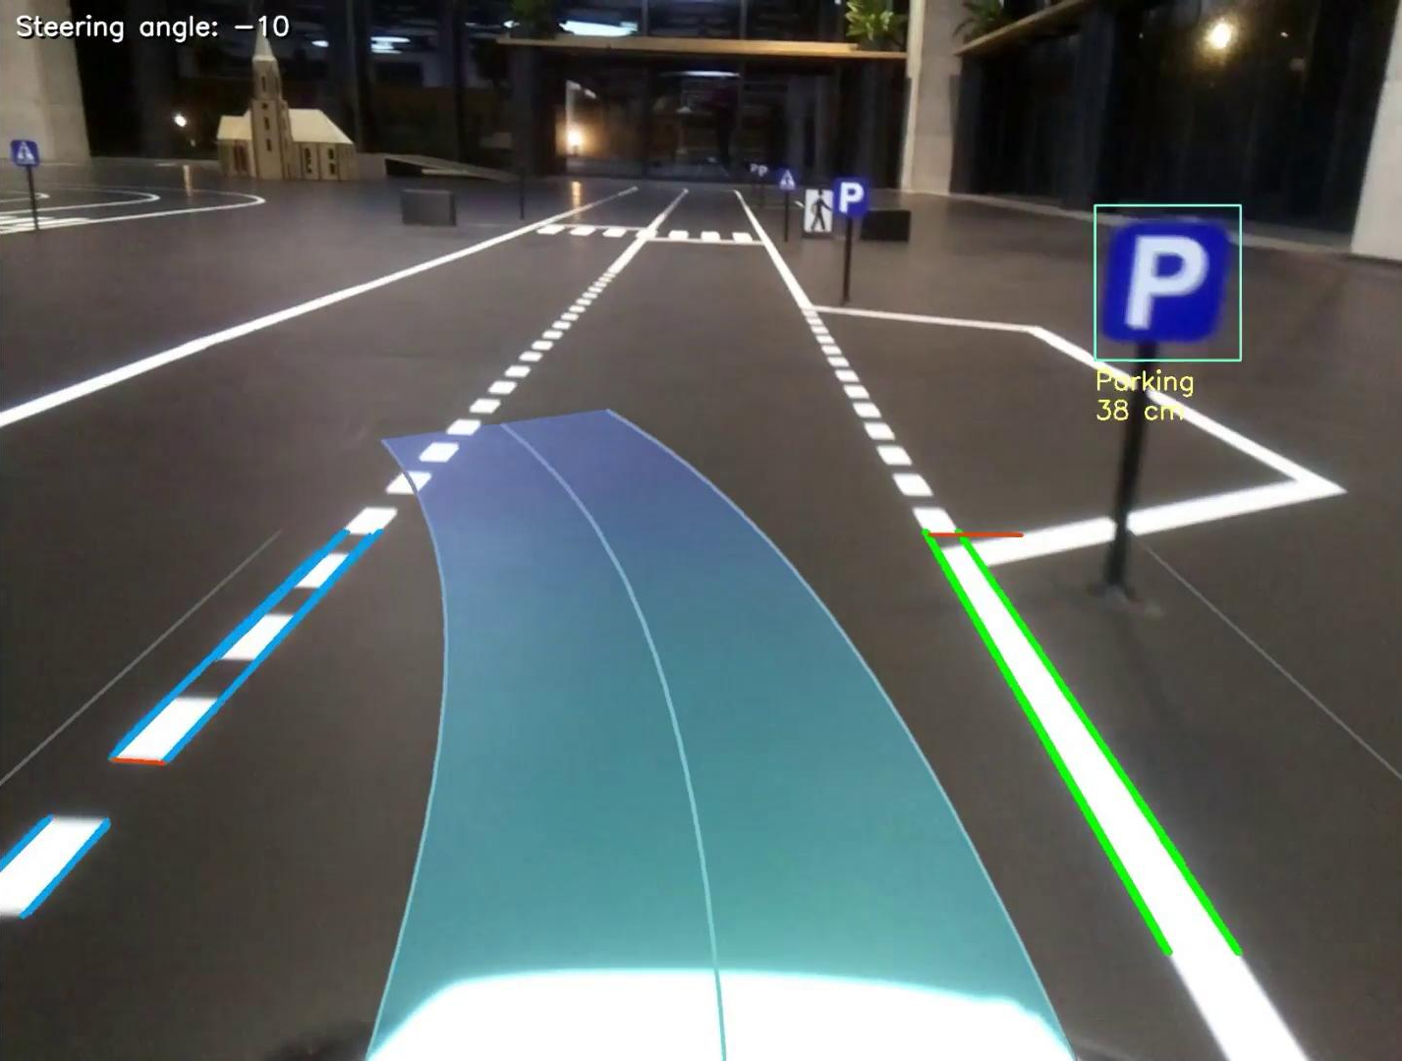
Results - distance to sign computed

Slide 36
Conclusions
-> In conclusion, this module represents a robust solution for detecting and recognizing miniature traffic signs.
-> Due to the implementation in C++, the algorithm is optimized for embedded systems.
-> Because there are two methods of extracting ROIs, the algorithm will work in scenarios where colors are not represented correctly or the pole of the traffic sign is not visible.
-> The idea of detecting traffic signs based on the pole is a new idea, and due to the configurable parameters of the algorithm it can be scaled for real scenarios.
-> Recognition based on a neural network brings flexibility to the solution, the operation being robust even in conditions with uncontrolled brightness of the environment.

Slide 37
References
[1] P. Sermanet and Y. LeCun, "Traffic sign recognition with multi-scale Convolutional Networks,"
The 2011 International Joint Conference on Neural Networks, San Jose, CA, 2011, pp. 2809-2813.
[2] Fang, Mei & Yue, GuangXue & Yu, QingCang. (2009). The Study on An Application of Otsu Method in
Canny Operator.

Slide 38
Thank you for your attention!

